Slide 1


Exercise Physiology IITs
Can heat therapy help exercise recovery?

Slide 2
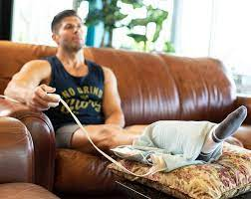
Background
Explain the specific relevant background necessary for the question/research
Heat relaxes muscles
Heat may help athletes
Heat requires hydration
Explain why the research question or aim of the study is important.
They are important because the development of the protocol and design of study

Slide 3
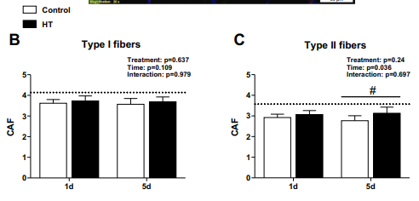
Findings
What was the answer for your research question in detail?
groin exposed to HT
control therapy
early local heating
strong eccentric exercise reduces local pain
eccentric exercise pain
control intervention
increases blood flow by heat-induced
sensitize muscle nociceptors.

Slide 4
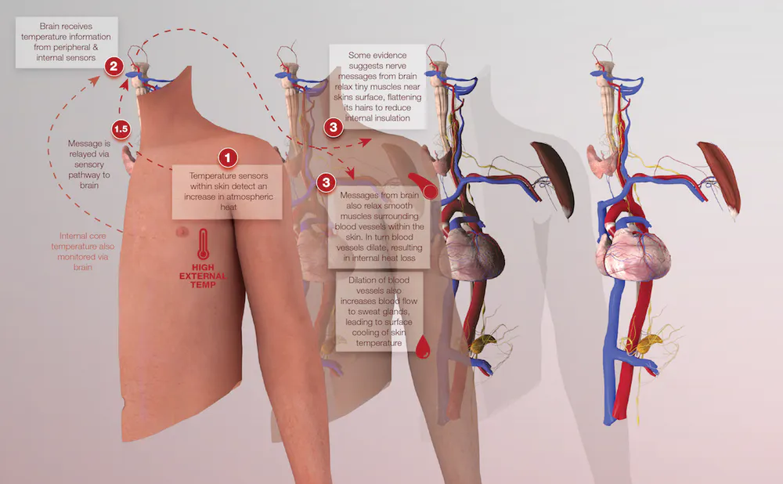
Physiological mechanisms and critical appraisal
Why do the findings of your research question occur with physiological detail? Is there other literature which confirms or contrasts your findings and are there any shortcoming or weaknesses in the literature approaching this research question.
muscle fibers production
satellite cells
mechanical hyperalgesia
muscle nerve growth
physical inactivity-induced
HT , skeletal muscle recovery damage
inflammatory cells
M1 macrophages
satellite cells
factor content
Fibrosis
growth factor

Slide 5
References
24 -McArdle A, Dillmann WH, Mestril R, Faulkner JA, Jackson MJ. Overexpression of HSP70 in mouse skeletal muscle protects against muscle damage and age-related muscle dysfunction. FASEB J 18: 355– 357, 2004. doi:10.1096/fj.03-0395fje
36- Petrofsky J, Berk L, Bains G, Khowailed IA, Lee H, Laymon M. The efficacy of sustained heat treatment on delayed-onset muscle soreness. Clin J Sport Med 27: 329–337, 2017. doi:10.1097/JSM.0000000000000375
13- Heinonen I, Brothers RM, Kemppainen J, Knuuti J, Kalliokoski KK, Crandall CG. Local heating, but not indirect whole body heating, increases human skeletal muscle blood flow. J Appl Physiol (1985) 111: 818 –824, 2011. doi:10.1152/japplphysiol.00269.2011.
4. Beaton LJ, Tarnopolsky MA, Phillips SM. Contraction-induced muscle damage in humans following calcium channel blocker administration. J Physiol 544: 849 –859, 2002. doi:10.1113/jphysiol.2002.022350.
10. Crameri RM, Aagaard P, Qvortrup K, Langberg H, Olesen J, Kjaer M. Myofibre damage in human skeletal muscle: effects of electrical stimulation versus voluntary contraction. J Physiol 583: 365–380, 2007. doi:10.1113/jphysiol.2007.128827.
27. Mizumura K, Taguchi T. Delayed onset muscle soreness: involvement of neurotrophic factors. J Physiol Sci 66: 43–52, 2016. doi:10.1007/s12576- 015-0397-0
. Nakagawa T, Hiraga SI, Mizumura K, Hori K, Ozaki N, Koeda T. Topical thermal therapy with hot packs suppresses physical inactivityinduced mechanical hyperalgesia and up-regulation of NGF. J Physiol Sci 68: 629 –637, 2018. doi:10.1007/s12576-017-0574-4.
31. Novak ML, Weinheimer-Haus EM, Koh TJ. Macrophage activation and skeletal muscle healing following traumatic injury. J Pathol 232: 344 – 355, 2014. doi:10.1002/path.4301.
34. Paulsen G, Crameri R, Benestad HB, Fjeld JG, Mørkrid L, Hallén J, Raastad T. Time course of leukocyte accumulation in human muscle after eccentric exercise. Med Sci Sports Exerc 42: 75–85, 2010. doi:10.1249/ MSS.0b013e3181ac7adb.
Impact of heat therapy on recovery after eccentric exercise in humans. Kim, 2019.

